Slide 1
Short Term Financing
Nature of short-term financing;
Advantages and disadvantages;
Sources of short-term financing: Accruals, Accounts Payable (Trade Credit), Commercial Paper, Short-term Bank Loans, Line of Credit, Revolving Credit Arrangement, Transaction Loans;
Choosing a bank;
Comparison of cost of trade credit, commercial paper, and short-term bank loan;
Use of security in short-term financing: inventory financing and accounts receivable financing;
Factors affecting in choosing the appropriate sources of short-term financing

Slide 2
Nature of Short Term Financing
Liabilities or obligation that are originally schedule for repayment within one year
Funds are used to:
support current assets such as cash, marketable securities, inventories and others current assets
Meet regular expenses like wages, salary, repair and maintenance, taxes and so on
Take advantage of cash discount and off season purchase
Short term bridge loan to finance purchase of new equipment
Quantity of funds needed depends on nature, size of business, time and cost of production, terms of sales and purchase etc
Comparatively cheaper than other sources of financing
Short term financing does not always correspond exactly to the current liabilities shown on the firms balance sheet

Slide 3
Advantages/ Disadvantages of Short Term Financing
Advantages:
Less costly
Speed
Less Restriction
Collateral
Flexibility
Disadvantages:
High Risk
Limited Use of Funds
Limited Amount of Financing

Slide 4
Sources of Short Term Financing
Unsecured Sources
Spontaneous Sources
* Accruals
* Trade Credit
Non Spontaneous Sources
1. Bank Loan :
* Transaction Loan
* Line of Credit
* Revolving line of credit
2. Money Market Credit:
* Commercial Paper
* Bankers Acceptance
Secured Sources
Inventory Financing
* Floating Lien
* Chattel Mortgage
* Trust Receipt Loan
* Field warehouse receipt loan
* Terminal warehouse receipt loan
Account Receivable Financing
* Pledging Accounts Receivable
* Factoring Accounts Receivables

Slide 5
Accruals
Spontaneous Sources of Financing
Liability for services received for which payment has yet to be made
Most common accruals are wages and taxes payable
Accruals of wages can be manipulated by firm but not accruals of taxes
No interest is paid on the fund raised from this source
Example:
Jayanti Trading Company currently pays its employees at the end of each work week. The weekly payroll totals Rs 400,000. If the firm were to extend the pay periods so as to pay its employees 1 week later throughout an entire year, the employees would in effect be lending the firm Rs 400,000 for a year. If the firm could earn 10% annually on invested funds, such a strategy would be worth Rs 40,000 per year (0.10 × Rs 400,000)
Deferred Income: Funds received by the firm for goods and services which it has agreed to supply in future.

Slide 6
Trade Credit (Account Payable)
Credit that a firm gets from its suppliers of goods
Spontaneous
Main source of unsecured sources of financing
Credit by one business to another
Amount of credit depends upon per day purchase and credit period
Advantages:
Easy Availability
Virtual Subsidy
Flexibility
Informality
Less Costly
Disadvantage:
Limited Amount
Not source of cash
May be costly
Poor Credit Rating

Slide 7
Trade Credit or Account Payable
Open account credit
Seller simply records the name and amount of transaction and buyer does not sign in any paper. This type of transaction is made where degree of certainty is very high.
Promissory note
The Buyer signs a note to ensures to make payment in due date. The seller delivers goods only after sign is made by the buyer. When the buyer is unable to pay due on time, seller recovers the amount with the help of promissory note

Slide 8
Terms of sale
Net 30
The bill must be paid within 30 days from the invoice date
2/10 net 30
2 percent discount can be obtained if the payment is made within 10 days; otherwise, whole payment should be made within 30 days.
Net 10 EOM
All goods shipped before the end of month must be paid10th of the following month. In other words, credit period begins from the end of month
2/10 net 30 EOM
Time of discount and credit period begins from the end of month
2/10 net 30 MOM
Discount period and credit period begins from the middle of the month if the invoice date lies between 1 to 15 and begins from the end of the month if the invoice date lies between 15th to last date of the month.

Slide 9
Credit Terms and Payment Date
Invoice Date | Credit Term | Payment dates
 |  | Discount Taken | Discount Forgone
May 10 | 2 / 10 net 30 | May 20 | June 10
May 10 | 2/ 10 net 30 EOM | June 10 | June 30
May 10 | 2/10 net 30 MOM | May 25 | June 15
May 20 | 2/10 net 30 MOM | June 10 | June 30
May 10 | Net 30 | - | June 10
May 10 | Net 10 EOM | - | June 10

Slide 10
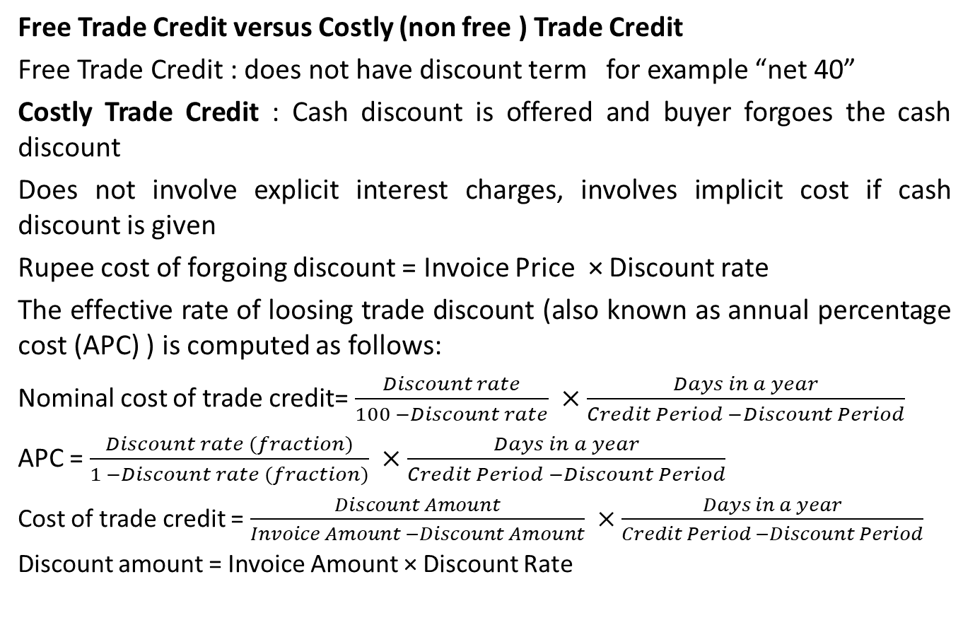
Trade Credit (Account Payable)
Free Trade Credit versus Costly (non free ) Trade Credit
Free Trade Credit : does not have discount term for example “net 40”
Costly Trade Credit : Cash discount is offered and buyer forgoes the cash discount
Does not involve explicit interest charges, involves implicit cost if cash discount is given
Rupee cost of forgoing discount = Invoice Price × Discount rate
The effective rate of loosing trade discount (also known as annual percentage cost (APC) ) is computed as follows:
Nominal cost of trade credit= $\frac{Discount rate}{100 −Discount rate} ×\frac{Days in a year}{Credit Period −Discount Period}$
APC = $\frac{Discount rate (fraction)}{1 −Discount rate (fraction)} ×\frac{Days in a year}{Credit Period −Discount Period}$
Cost of trade credit = $\frac{Discount Amount}{Invoice Amount −Discount Amount} ×\frac{Days in a year}{Credit Period −Discount Period}$
Discount amount = Invoice Amount × Discount Rate

Slide 11
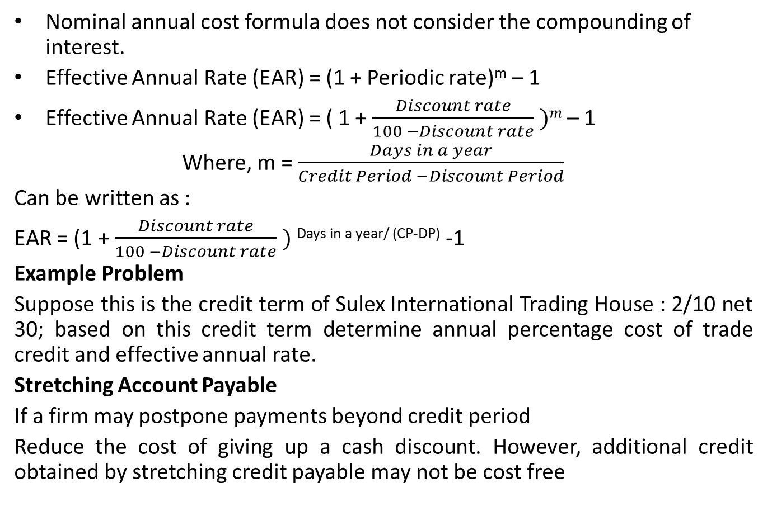
Trade Credit (Account Payable)
Nominal annual cost formula does not consider the compounding of interest.
Effective Annual Rate (EAR) = (1 + Periodic rate)^{m} – 1
Effective Annual Rate (EAR) = ( 1 + $\frac{Discount rate}{100 −Discount rate} )m$ – 1
Where, m = $\frac{Days in a year}{Credit Period −Discount Period}$
Can be written as :
EAR = (1 + $\frac{Discount rate}{100 −Discount rate} )$ ^{Days in a year/ (CP-DP)} -1
Example Problem
Suppose this is the credit term of Sulex International Trading House : 2/10 net 30; based on this credit term determine annual percentage cost of trade credit and effective annual rate.
Stretching Account Payable
If a firm may postpone payments beyond credit period
Reduce the cost of giving up a cash discount. However, additional credit obtained by stretching credit payable may not be cost free

Slide 12
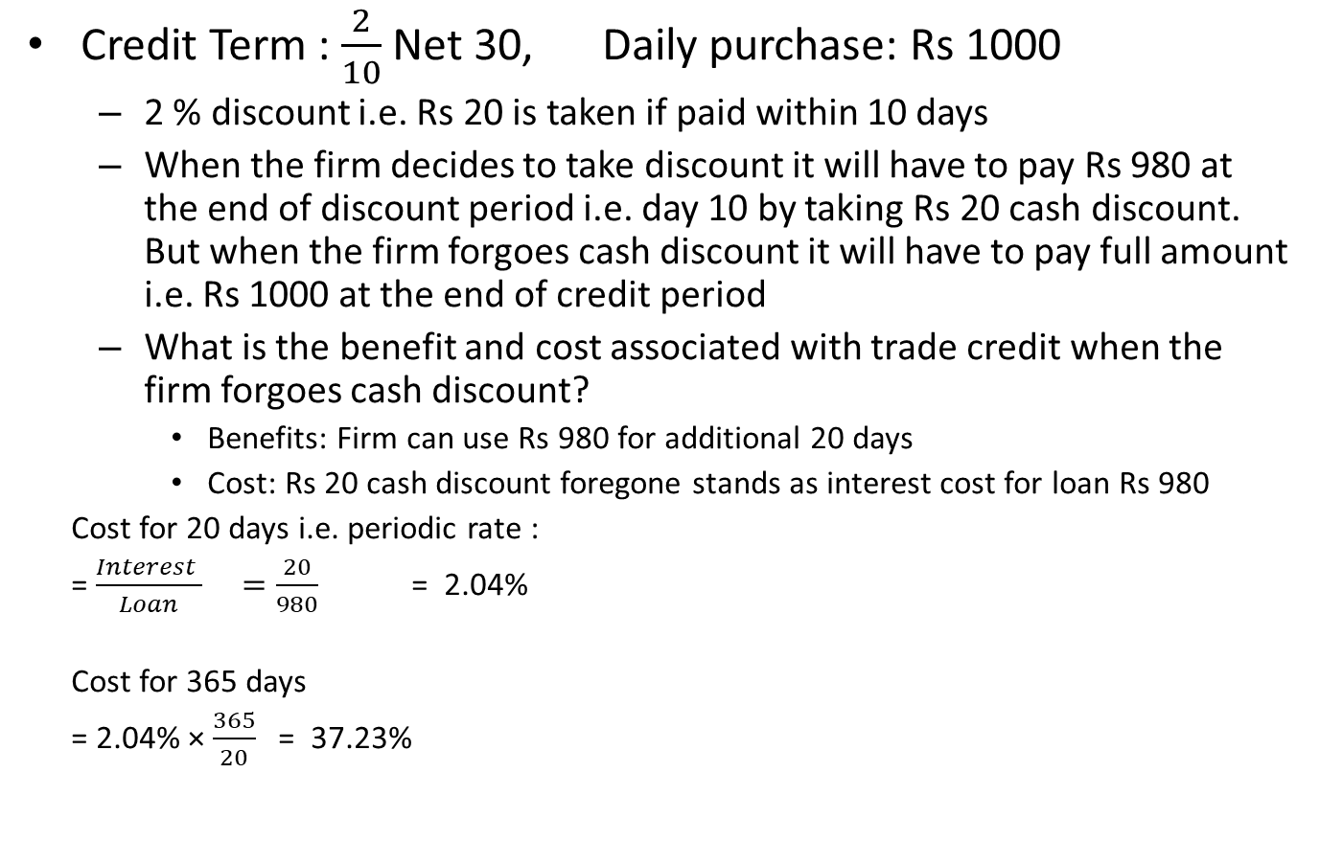
Example
Credit Term : $\frac{2}{10}$Net 30, Daily purchase: Rs 1000
2 % discount i.e. Rs 20 is taken if paid within 10 days
When the firm decides to take discount it will have to pay Rs 980 at the end of discount period i.e. day 10 by taking Rs 20 cash discount. But when the firm forgoes cash discount it will have to pay full amount i.e. Rs 1000 at the end of credit period
What is the benefit and cost associated with trade credit when the firm forgoes cash discount?
Benefits: Firm can use Rs 980 for additional 20 days
Cost: Rs 20 cash discount foregone stands as interest cost for loan Rs 980
Cost for 20 days i.e. periodic rate :
= $\frac{Interest }{Loan} =\frac{20}{980}$ = 2.04%
Cost for 365 days
= 2.04% × $\frac{365}{20}$ = 37.23%

Slide 13
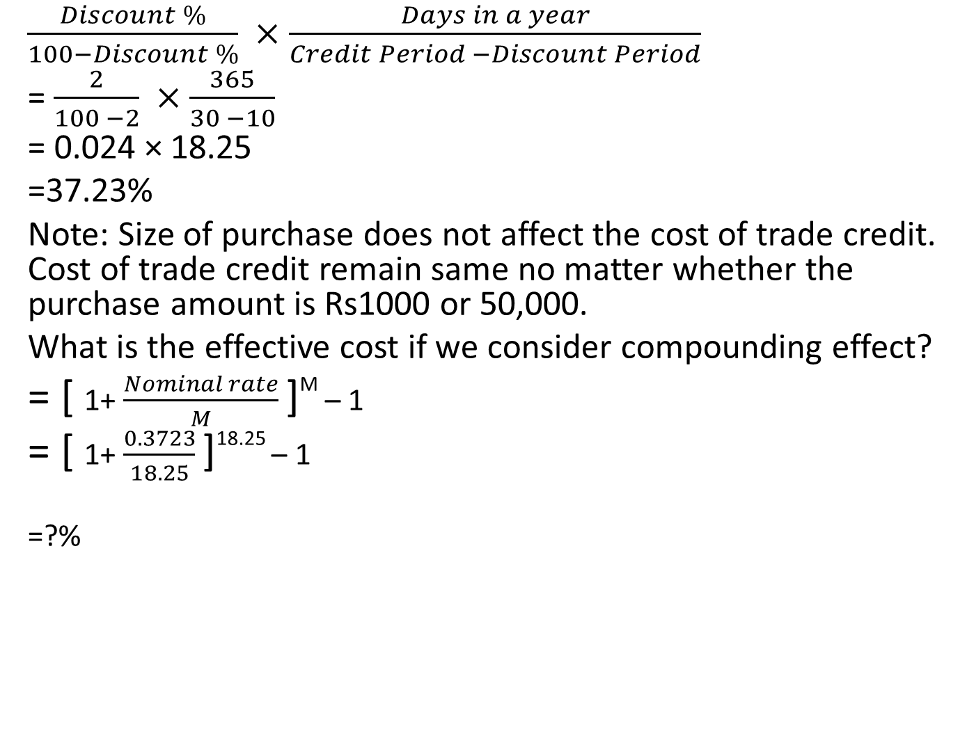
Approximate nominal Cost (non-free) of Trade Credit
$\frac{Discount \%}{100−Discount \%} ×$ $\frac{Days in a year}{Credit Period −Discount Period}$
= $\frac{2}{100 −2} ×$ $\frac{365}{30 −10}$
= 0.024 × 18.25
=37.23%
Note: Size of purchase does not affect the cost of trade credit. Cost of trade credit remain same no matter whether the purchase amount is Rs1000 or 50,000.
What is the effective cost if we consider compounding effect?
= [ 1+ $\frac{Nominal rate}{M}$]^{M} – 1
= [ 1+ $\frac{0.3723}{18.25}$]^{18.25} – 1
=?%

Slide 14
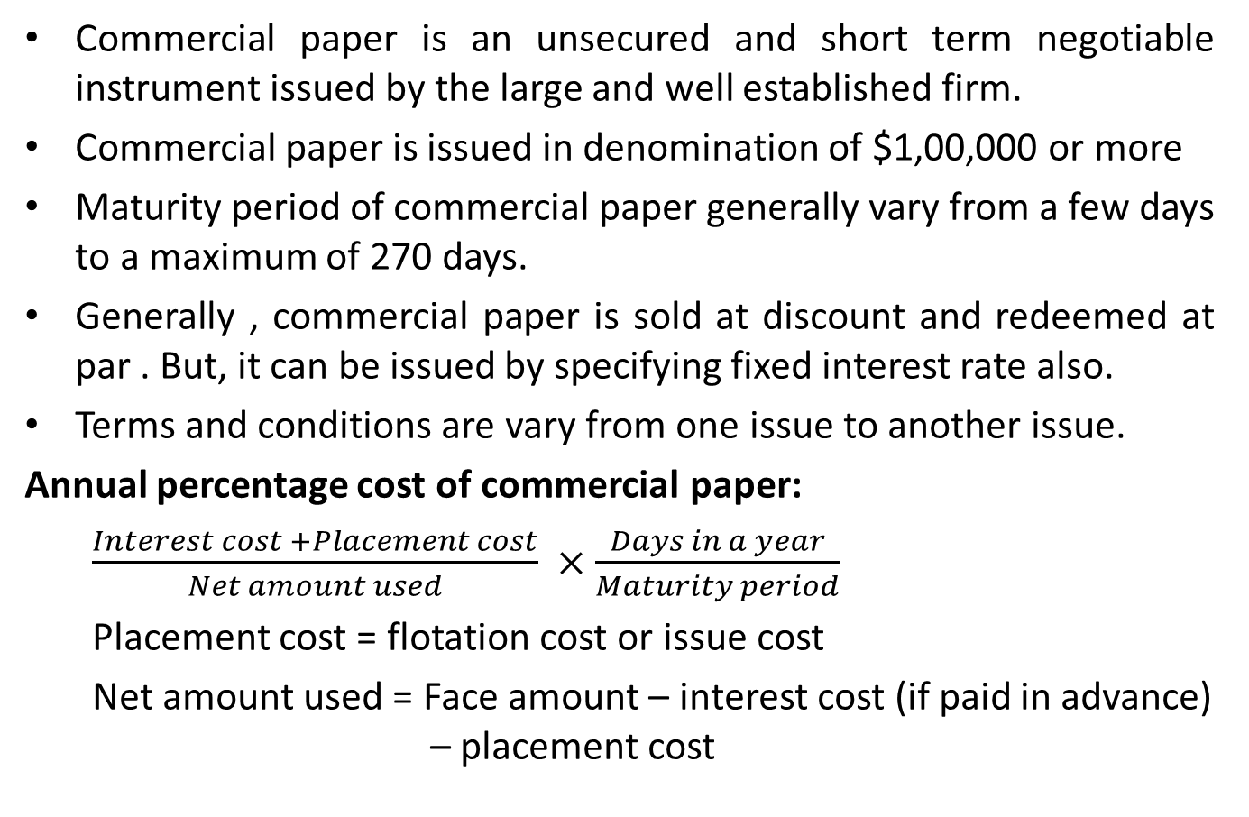
C. Commercial Paper
Commercial paper is an unsecured and short term negotiable instrument issued by the large and well established firm.
Commercial paper is issued in denomination of $1,00,000 or more
Maturity period of commercial paper generally vary from a few days to a maximum of 270 days.
Generally , commercial paper is sold at discount and redeemed at par . But, it can be issued by specifying fixed interest rate also.
Terms and conditions are vary from one issue to another issue.
Annual percentage cost of commercial paper:
$\frac{Interest cost +Placement cost}{Net amount used} ×$ $\frac{Days in a year}{Maturity period}$
Placement cost = flotation cost or issue cost
Net amount used = Face amount – interest cost (if paid in advance) – placement cost

Slide 15
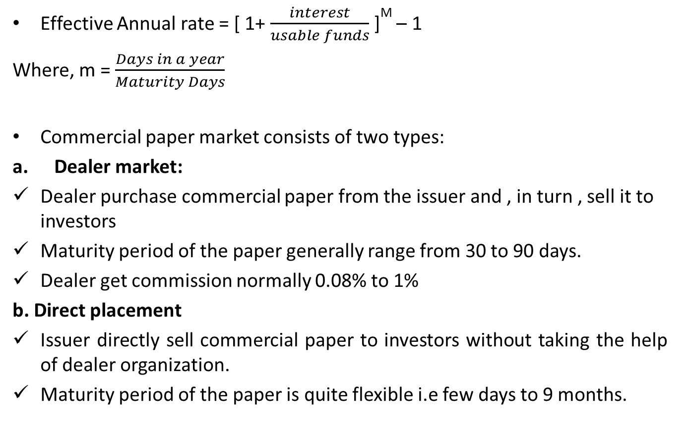
Commercial paper
Effective Annual rate = [ 1+ $\frac{interest}{usable funds}$]^{M} – 1
Where, m = $\frac{Days in a year}{Maturity Days}$
Commercial paper market consists of two types:
Dealer market:
Dealer purchase commercial paper from the issuer and , in turn , sell it to investors
Maturity period of the paper generally range from 30 to 90 days.
Dealer get commission normally 0.08% to 1%
b. Direct placement
Issuer directly sell commercial paper to investors without taking the help of dealer organization.
Maturity period of the paper is quite flexible i.e few days to 9 months.

Slide 16
Commercial paper
Advantages :
It is generally cheaper than a short term bank loan.
Dealer provides useful information
No pledge of collateral
Publicity and prestige to issuing company
Disadvantages :
Large sum of money can not be raised
Unsuitable for small firm
Lack of flexibility.

Slide 17
Example Problem
Softtech Company, a large shipbuilder has just issued Rs 1 million worth of commercial paper that has a 90 day maturity and sells for Rs 980,000. At the end of the 90 days, the purchaser of this paper will receive Rs 1 million for its Rs 980,000 investment. Compute annual percentage cost and effective annual rate on this commercial paper.

Slide 18
D . Short term bank loan/ Bank credit
Short term bank loan is non-spontaneous, interest paying and negotiated credit. Short term bank loan appears on balance sheet as notes payable
Short term bank loan is generally unsecured and self liquidating in nature.
Characteristics:
Forms of loan:
Transaction loan: Transaction loan is taken for a specific purpose for a certain period of time. Transaction loan is repaid either lump sum at maturity or in installment basis through out the loan period
Line of credit: It is an informal agreement between borrower and the bank under which the bank agrees to lend up to a specified maximum amount of funds at any time during a specified period. Borrower has to pay interest on borrowed(used) amount.

Slide 19
c. Revolving line of credit: It is a formal and legal commitment by the bank under which the bank agrees to lend up to a specified maximum amount of funds at any time up to a specified period of time.
The firm has to pay interest on used amount and commitment fee on unused amount.
ii. Compensating balance: Minimum balance of loan that must be maintained by the borrower with a bank throughout the loan period to obtain loan and other service.
For eg:
Loan amount Rs 1,00,000
Compensating balance 10%
Net amount available for use= Rs1,00,000- 10% of 1,00,000
Rs90,000
Interest cost:10% of 100,000= Rs10,000
Effective cost: 10,000/90,000= ?

Slide 20
iii. Agreement paper
A document in which all the terms and conditions are specified such as loan amount, interest rate, modes of payment and other terms and conditions.
iv. Maturity
Less than one year maturity period
v. Security
Loan can be obtained with or without keeping assets as collateral.

Slide 21
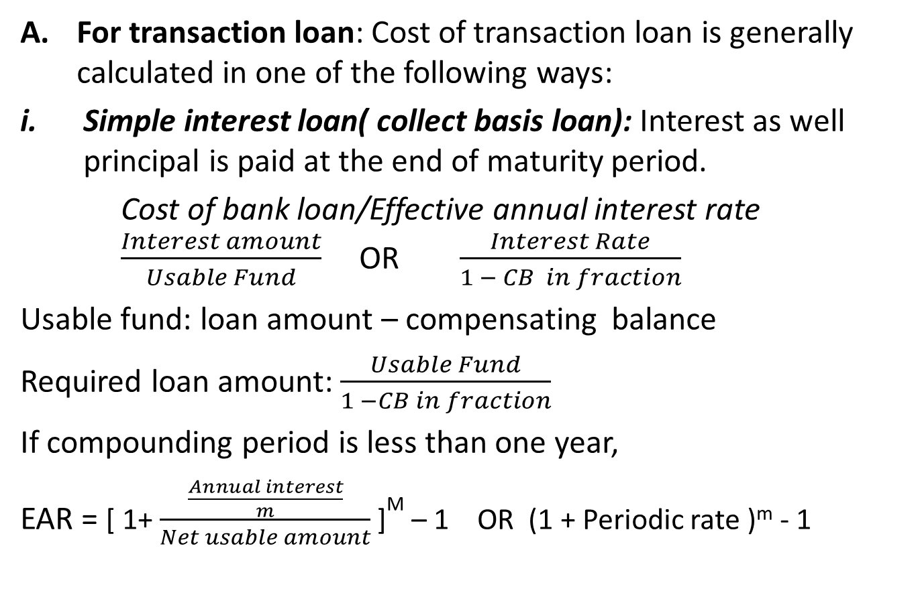
Methods of computing cost of Bank loan
For transaction loan: Cost of transaction loan is generally calculated in one of the following ways:
Simple interest loan( collect basis loan): Interest as well principal is paid at the end of maturity period.
Cost of bank loan/Effective annual interest rate $\frac{Interest amount}{Usable Fund}$ OR $\frac{Interest Rate}{1 − CB in fraction}$
Usable fund: loan amount – compensating balance
Required loan amount: $\frac{Usable Fund}{1 −CB in fraction}$
If compounding period is less than one year,
EAR = [ 1+ $\frac{\frac{Annual interest}{m}}{Net usable amount}$]^{M} – 1 OR (1 + Periodic rate )^{m} - 1

Slide 22
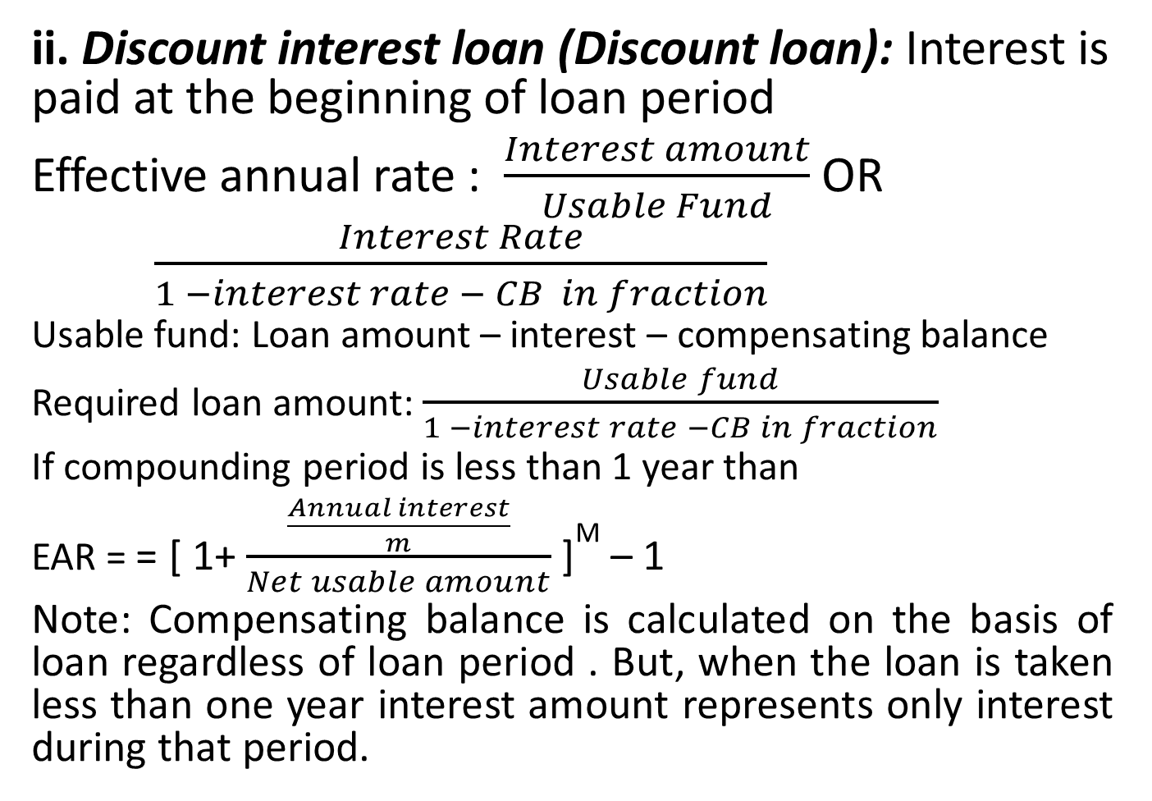
Transaction loan:
ii. Discount interest loan (Discount loan): Interest is paid at the beginning of loan period
Effective annual rate : $\frac{Interest amount}{Usable Fund}$ OR
$\frac{Interest Rate}{1 −interest rate − CB in fraction}$
Usable fund: Loan amount – interest – compensating balance
Required loan amount: $\frac{Usable fund}{1 −interest rate −CB in fraction}$
If compounding period is less than 1 year than
EAR = = [ 1+ $\frac{\frac{Annual interest}{m}}{Net usable amount}$]^{M} – 1
Note: Compensating balance is calculated on the basis of loan regardless of loan period . But, when the loan is taken less than one year interest amount represents only interest during that period.

Slide 23
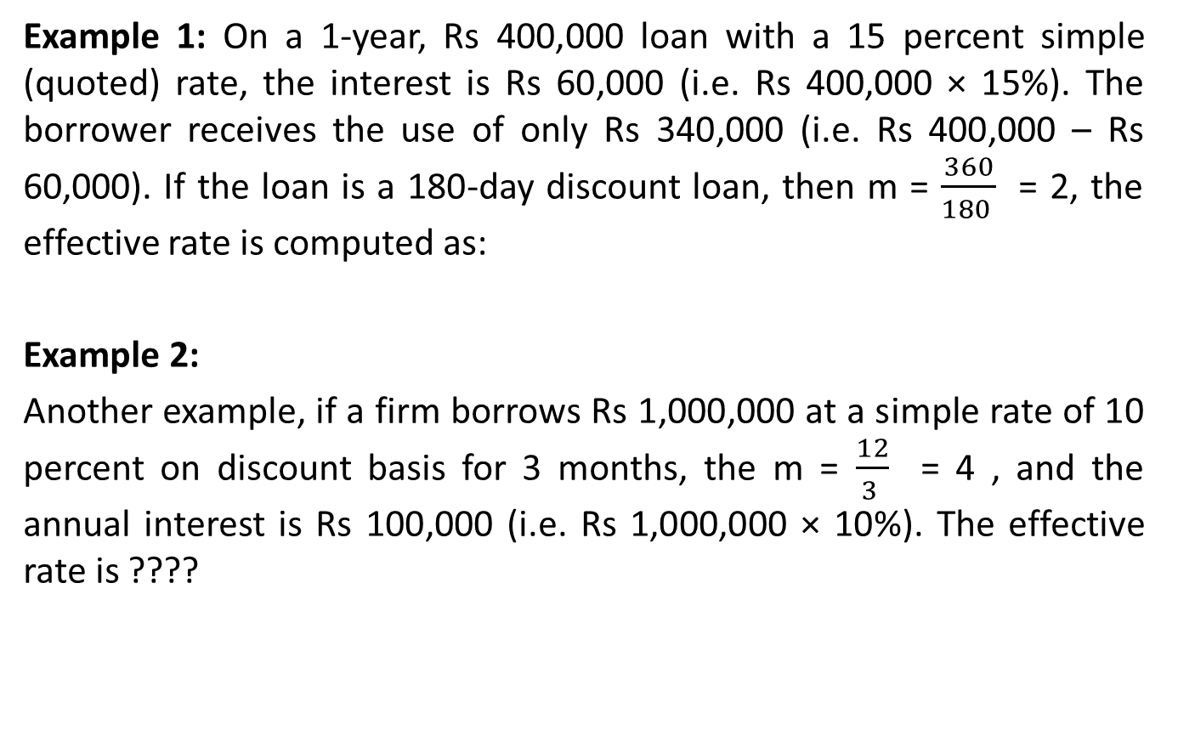
Transaction loan:
Example 1: On a 1-year, Rs 400,000 loan with a 15 percent simple (quoted) rate, the interest is Rs 60,000 (i.e. Rs 400,000 × 15%). The borrower receives the use of only Rs 340,000 (i.e. Rs 400,000 – Rs 60,000). If the loan is a 180-day discount loan, then m = $\frac{360}{180 }$ = 2, the effective rate is computed as:
Example 2:
Another example, if a firm borrows Rs 1,000,000 at a simple rate of 10 percent on discount basis for 3 months, the m = $\frac{12}{3 }$ = 4 , and the annual interest is Rs 100,000 (i.e. Rs 1,000,000 × 10%). The effective rate is ????

Slide 24
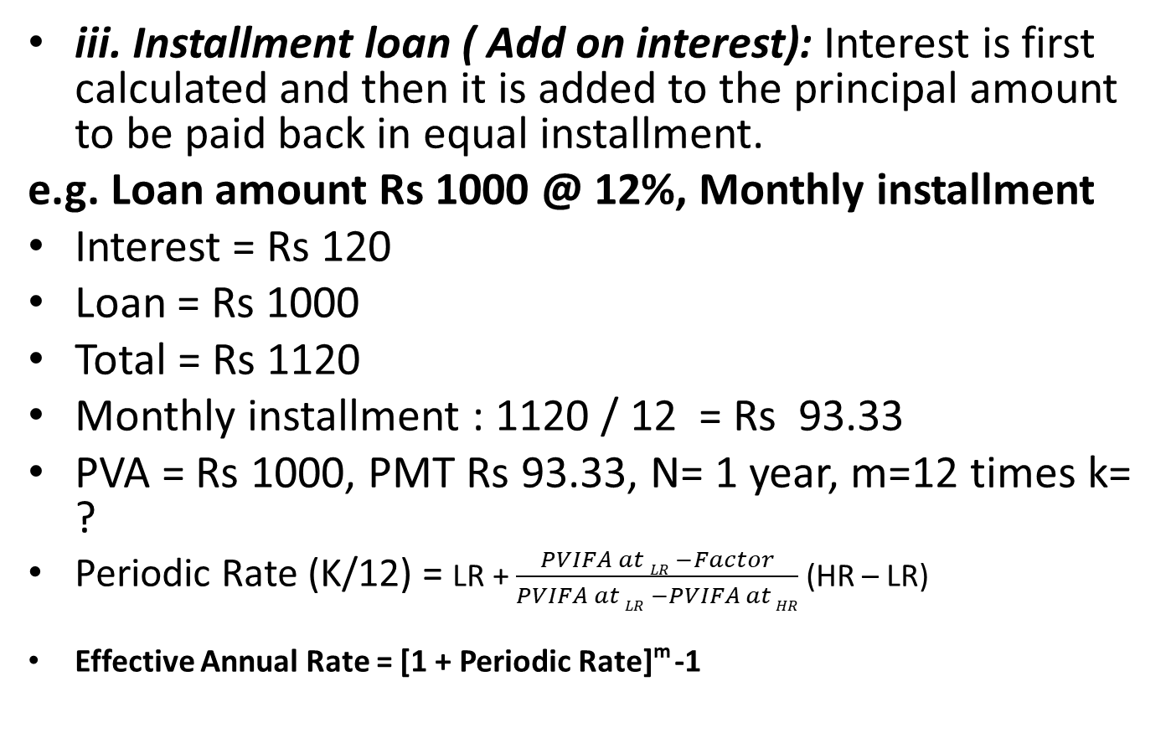
Transaction loan:
iii. Installment loan ( Add on interest): Interest is first calculated and then it is added to the principal amount to be paid back in equal installment.
e.g. Loan amount Rs 1000 @ 12%, Monthly installment
Interest = Rs 120
Loan = Rs 1000
Total = Rs 1120
Monthly installment : 1120 / 12 = Rs 93.33
PVA = Rs 1000, PMT Rs 93.33, N= 1 year, m=12 times k= ?
Periodic Rate (K/12) = LR + $\frac{PVIFA at LR −Factor}{PVIFA at LR −PVIFA at HR}$ (HR – LR)
Effective Annual Rate = [1 + Periodic Rate]^{m} -1

Slide 25
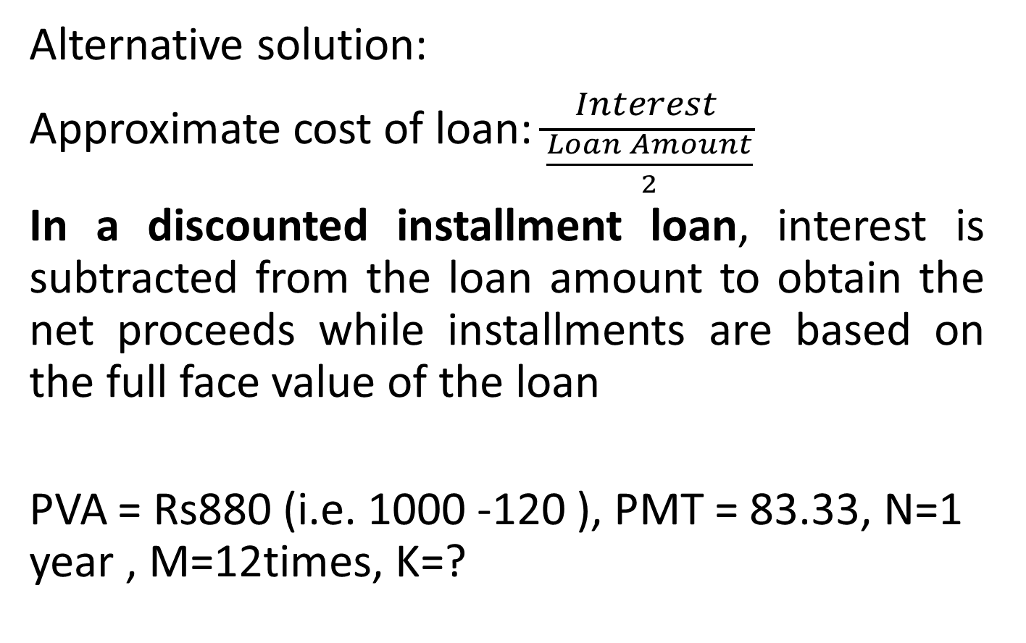
Installment loan
Alternative solution:
Approximate cost of loan: $\frac{Interest }{\frac{Loan Amount}{2}}$
In a discounted installment loan, interest is subtracted from the loan amount to obtain the net proceeds while installments are based on the full face value of the loan
PVA = Rs880 (i.e. 1000 -120 ), PMT = 83.33, N=1 year , M=12times, K=?

Slide 26
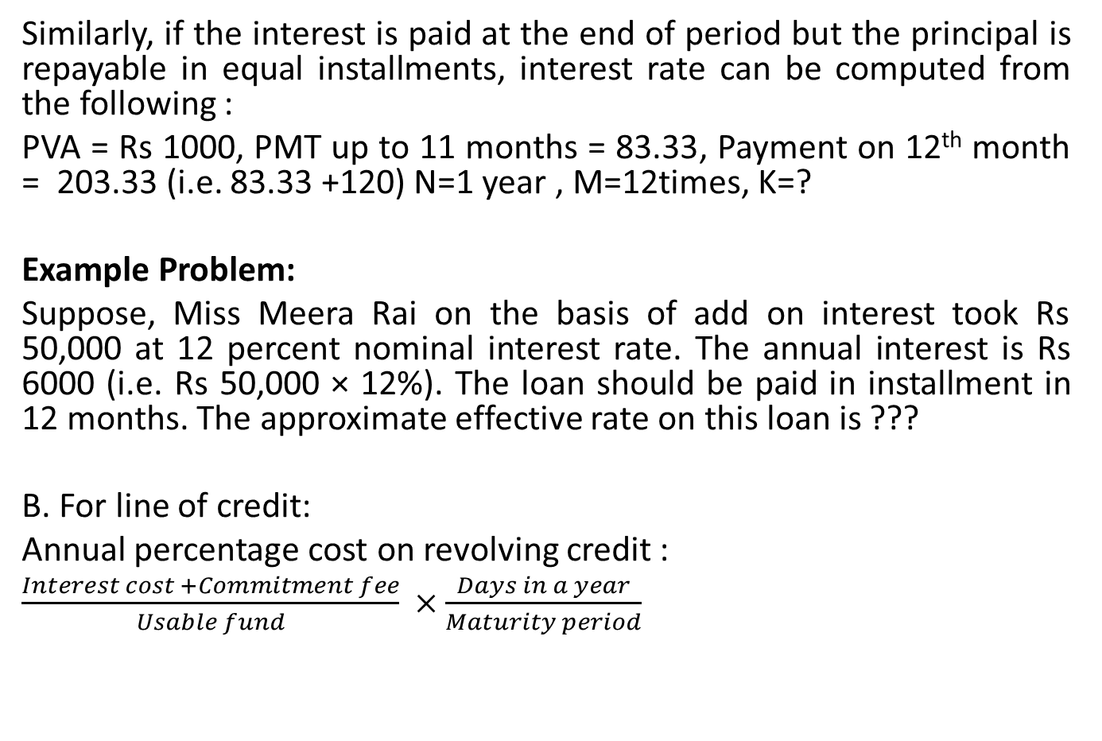
Installment loan
Similarly, if the interest is paid at the end of period but the principal is repayable in equal installments, interest rate can be computed from the following :
PVA = Rs 1000, PMT up to 11 months = 83.33, Payment on 12th month = 203.33 (i.e. 83.33 +120) N=1 year , M=12times, K=?
Example Problem:
Suppose, Miss Meera Rai on the basis of add on interest took Rs 50,000 at 12 percent nominal interest rate. The annual interest is Rs 6000 (i.e. Rs 50,000 × 12%). The loan should be paid in installment in 12 months. The approximate effective rate on this loan is ???
B. For line of credit:
Annual percentage cost on revolving credit :
$\frac{Interest cost +Commitment fee}{Usable fund} ×$ $\frac{Days in a year}{Maturity period}$

Slide 27
Secured lending Arrangement:
Is there any guarantee that all firms can get credit(loan) on an unsecured basis?
No , if the firms are new, bank will demand collateral from the borrower. Not only this, beyond a point in risk, each and every lender will demand security. If the borrower default the loan, the lender sell the collateral and recover the loan.
Sometimes sale proceeds may be greater than loan. In such a situation the differences should be remitted to the borrower but if the sales proceeds are less than that of loan, the difference will be treated as unsecured creditor.

Slide 28
Types of secured short term financing:
Accounts Receivable Financing : Accounts receivable financing consists of ;
Pledging ( Assignment) of Receivable
Factoring of Receivable
i. Pledging of Receivable:
Accounts receivable represents one of the most liquid assets of the firm therefore they make good security for a loan . The lender has to face two major problems such as cost of processing receivable and risk of fraud.
How much to lend against receivable?

Slide 29
Pledging of Receivable
It depends upon quality and size of receivable. If the quality of receivable is good, there may be higher amount of loan against receivable. There is no compulsory to accept all the receivable by the lender. Lender may reject that type of receivable whose credit rating is poor.
Depending upon quality of receivable, lender typically advances between 50 and 80 percent of their face value.
If the size of receivable is small, administrative cost will be high. So that lender may reject to provide loan. If accept, the lender will provide loan against receivable based on bulk assignment basis. (adding small bills and providing certain percent of bulk amount)

Slide 30
Pledging of receivable
Borrower and lender sit together
Schedule of receivable must be submitted to the lender
Lender evaluates the receivable and finally provide loan against receivable.
Receivable financing may be;
Non notification basis: customers of the firm are not informed that their receivables are played as collateral.
What will happen when the due date come ?
When the firm receives payment that must be submitted to the lender as soon as possible.

Slide 31
Pledging of Receivable
ii. Notification basis: customers of the firm are informed that their receivables are played as collateral.
Borrower prefer non notification basis but the lender prefer notification basis.
What will happen when the customers do not make payment on the due date?
The lender can seek payment from the borrower when the pledged receivables is uncollectible , called recourse. Therefore , the risk of default remains with the borrower.

Slide 32
Factoring Receivable
In the assignment of receivable, the firm retains title to the receivables but when a firm factor its receivables, it actually sells them to a factor generally without recourse to the borrower , which means that if the buyer of goods does not pay for them , the lender(factor) rather than the seller(borrower) takes the loss.
Who are factors?
Factors are : financial institution or a professional that purchase receivables of other firms.
When the firm sells receivables to the factor, the selling firm is free from the expense of maintaining credit department and making collections.

Slide 33
Factoring Receivable
Factor may reject those receivables particularly whose credit ratings are poor.
Factoring arrangements are governed by a contract between factor and the client. The contract frequently is for 1 year with an automatic provision for renewal and can be cancelled only with prior notice of 30 to 60 days
Under factoring, the customer who purchase the goods typically is notified and is asked to make payment directly to the lending institution
Factoring costs :
For bearing risk and servicing the receivables, the factor receives a commission i.e. factoring fee , typically somewhat over 1 % of the face value of the receivables

Slide 34
Factoring Receivable
If the firm wish to receive payment for the sale of receivable before they are actually collected, the firm has to pay interest to the factor.
E.g Total value of receivable = Rs10,000
Factoring fee= 2%
Amount credited to the firms a/c = Rs9,800
If the firm want to draw on this account before the receivables are collected, it will have to pay interest charge. If the interest rate is 1% per month, the interest cost will be Rs98
The total cost of factoring is composed of factoring fee and interest charge.

Slide 35
Example Problem
Kathmandu Dairy Product Limited is considering the following two methods of raising working capital
A commercial bank loan secured by account receivable
Factoring account receivable
The company’s bank has agreed to lend the company 80% of its average monthly accounts receivable balance of Rs 10,00,000 at an annual interest rate of 18%. The bank loan is in the form of a series of 30 day loan. The loan would be discounted, and a 15% compensating balance would also be required.
A factor has agreed to purchase company’s account receivable and to advance 90% of the balance to the company. The factor would charge 2% factoring commission and annual interest rate of 18% on the invoice price, less both the factoring would be deducted from the advance. The 10% of receivables not loaned to the firm under the factoring arrangement is held in the reserve account. The company can reduce an operating cost of Rs 4,000 per month by selecting factoring arrangement. In addition, bad debt losses of 2% of the monthly receivable will be avoided.
Which alternative should Kathmandu Dairy Product Limited select?

Slide 36
Example Problem
XYZ industries needs an additional Rs 250,000, which it plans to obtain through a factoring arrangement. The factor would purchase XYZ accounts receivable and advance the invoice amount less a 2 percent commission, on the invoices purchased each month. XYZ sells on the terms of net 30 days. In addition, the factor changes a 16 percent annual interest rate on the total invoice amount, to be deducted in advance.
What amount of account receivable must be factored to net Rs 250,000
If XYZ can reduce credit expenses by Rs 1,500 per month and avoid bad debt losses of 3 percent on the factored amount, what is the total rupee cost of factoring arrangement ?

Slide 37
Inventory Financing
Floating Lien (Inventory Blanket Lien)
In a business world, a loan or debt is usually against a fixed asset, such as land, equipment or any other. In a floating lien, however, the underlying collateral could be a current asset or a short term asset. Generally, the underlying asset in the floating charge could change in value from one period to another.
Floating Lien, or the floating charge, is a lien not on any specific asset, rather a set of assets or an asset class. We can say that such a lien allows a company to get a loan by keeping a set of assets as collateral. In this lien, the lender and the borrower doesn’t specify the asset, rather agree on a set of assets that are collateral.
The assets under this lien are usually those whose quantity and value may change regularly, such as inventory, accounts receivables and more.
Borrowers maintain full control of inventories and is free to sell and replace these inventories.

Slide 38
Inventory Financing
Chattel Mortgage
Inventory defined by serial number or any other means
Borrower has ownership over goods however lender has lien on inventory
Cannot be sold without consent of the lender
Not appropriate for inventories that cannot be identified easily but is considered more appropriate for capital goods like machinery, equipment etc

Slide 39
Inventory Financing
Trust Receipt
A document executed by a buyer in favour of a bank financing an important transaction, whereby the bank receives a security interest in the goods in exchange for releasing the documents required by the carrier for delivery. The buyer is obligated to maintain the goods or to proceeds from their resale at the disposal of the bank. Trust receipts are used under letters of credit or collections so that the buyer may receive the goods before paying the issuing bank or collecting bank.
In an arrangement involving a trust receipt, the bank remains the owner of the merchandise, but the buyer is allowed to hold the merchandise in trust for the bank, for manufacturing or sales purposes.
The trust receipt serves as a promissory note to the bank that the loan amount will be repaid upon sale of the goods

Slide 40
Inventory Financing
Warehousing
Warehousing is the process of storing physical goods before they are sold or further distributed. Warehouses safely and securely store products in an organized way to track where items are located, when they arrived, how long they have been there, and the quantity on hand.
3 key parts of warehousing logistic are:
Warehouse Management
Warehouse management is the strategic day-to-day running of operations in a warehouse to promote, improve, and ensure operational excellence.
Warehouse Operation
Warehousing operations refers to the processes that take place in a warehouse revolving around the movement of goods and tracking inventory.
Warehouse Management Systems
Warehouse Management System is a type of software that provides the tools necessary to manage warehouse operations and inventory movement to save time and eliminate manual processes.
Two Types:
Field Warehouse Receipt loan
Terminal Warehouse Receipt Loan

Slide 41
Non – fund based source:
Non –fund based financing : Credit facilities provided by the bank where actual bank`s funds are not involved. It can be;
Guarantees
Letter of credit
Deferred payment guarantees

Slide 42
Choosing a short term financing source
What sort of factors to be considered while selecting appropriate sources of short term ?
Cost : Others things held constant, it is better to go for that source which has low cost.
Reliability: Reliability associated with each other source should be considered. It is a great matter whether the firm can get required fund at the time of requirement or not.
Restrictions : So far possible, it is better to go for that source which has less restrictive covenants that limit the company`s activities.
Flexibility : Sources having greater flexibility helps to reduce cost and grasp market opportunity.

Slide 43
Choosing a short term financing sources
5. Collateral : It is better to go for that sources that do not require collateral.
6. Impact on credit rating: The firm should not sacrifice its goodwill in the name of reducing cost.
7. Period of time : Try to match the financing requirement and maturity period of debt.

